Slide 1

DIGITAL PORTFOLIO
NAME:E.BABYSHREE REGISTER NUMBER :2428K0012 COllEGE:SHREE VENKATESHWAR ARTS&SCIENCE DEPARTMENT : COMPUTER SCIENCE (AI&DS) UNIVERSITY :BHARATHIYAR UNIVERSITY

Slide 2
PERSONAL PORTFOLIO

Slide 3

Agenda
1.Problem Statement
2.Project overview
3.End Users
4.Tools and Technologies
5.Portfolio design and Layout
6.Features and Functionality
7.Results and Screenshot
8.Conclusion
9.GitHub Link

Slide 4
Problem Statement
In today’s competitive environment, showcasing skills, creativity, and experience is essential for standing out to potential employers, clients, or collaborators. Traditional resumes often fail to fully highlight an individual’s capabilities, practical projects, and unique strengths. Without a well-structured platform, it becomes difficult to present technical expertise, creativity, and personal achievements in a professional and engaging way

Slide 5
Project Overview
The Personal Portfolio Website is a digital platform designed to showcase my skills, projects, and achievements in web development and design. It provides a professional space where potential employers, collaborators, and peers can explore my work, learn about my background, and connect with me easily.
The portfolio highlights my technical expertise in HTML, CSS, JavaScript, and other tools while also reflecting my creativity and personal style. It includes sections such as an About Me page, Project Gallery, Resume/Skills section, and a Contact form for direct communication.

Slide 6
End Users
In a personal portfolio, end users are the people who will visit, view, and interact with your portfolio. They are the ones who benefit from the information you present.
Examples of End Users for a Personal Portfolio:
1. Potential Employers / Recruiters – to evaluate your skills and suitability for jobs.
2. Clients – if you’re offering freelance or project-based work.
3. Educators / Professors – if the portfolio is academic (to assess your learning and projects).
4. Peers / Colleagues – to collaborate or get inspiration.
5. General Audience – anyone interested in your creative, technical, or professional work.

Slide 7
Tools and Technologies
Frontend (user interface)
Backend ( Optional,if dynamic features are needed )
Databases(If required for projects/blogs
Design &Prototyping Tools
Version Control &Hosting
Enhancement and Tools
Analytics & SEO

Slide 8
Portfolio design and Layout
A portfolio design and layout should showcase your skills, projects, and personality in a clear, professional, and visually appealing way. Here’s a breakdown of how you can structure and design your personal portfolio:

Slide 9
Features and Functionality
When you write about Futures and Functionality in a personal portfolio, you are essentially showing how your portfolio (or the projects inside it) can grow, improve, and provide value in the long run. It makes your portfolio not just a showcase of what you did, but also a forward-looking plan that impresses recruiters, clients, or collaborators.

Slide 10
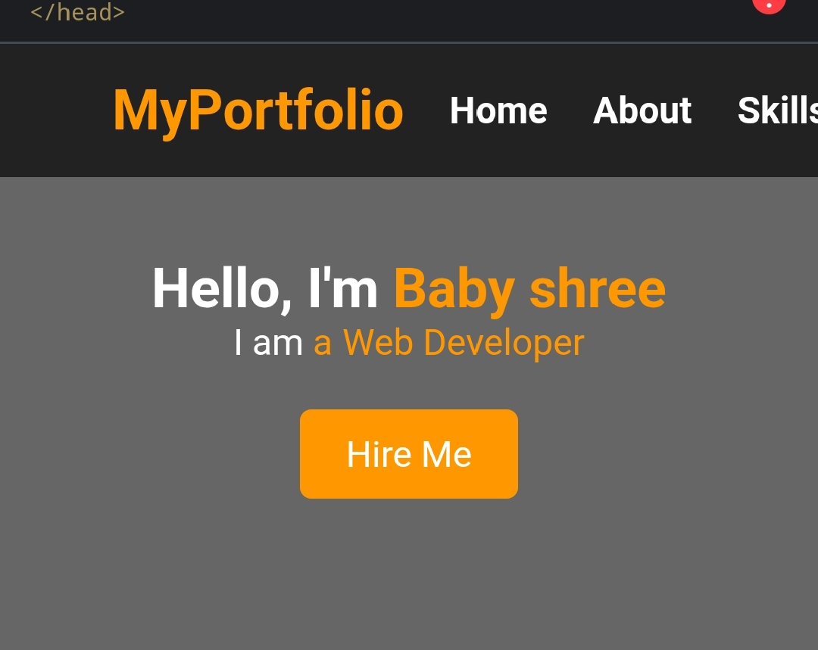
Results and Screenshot

Slide 11
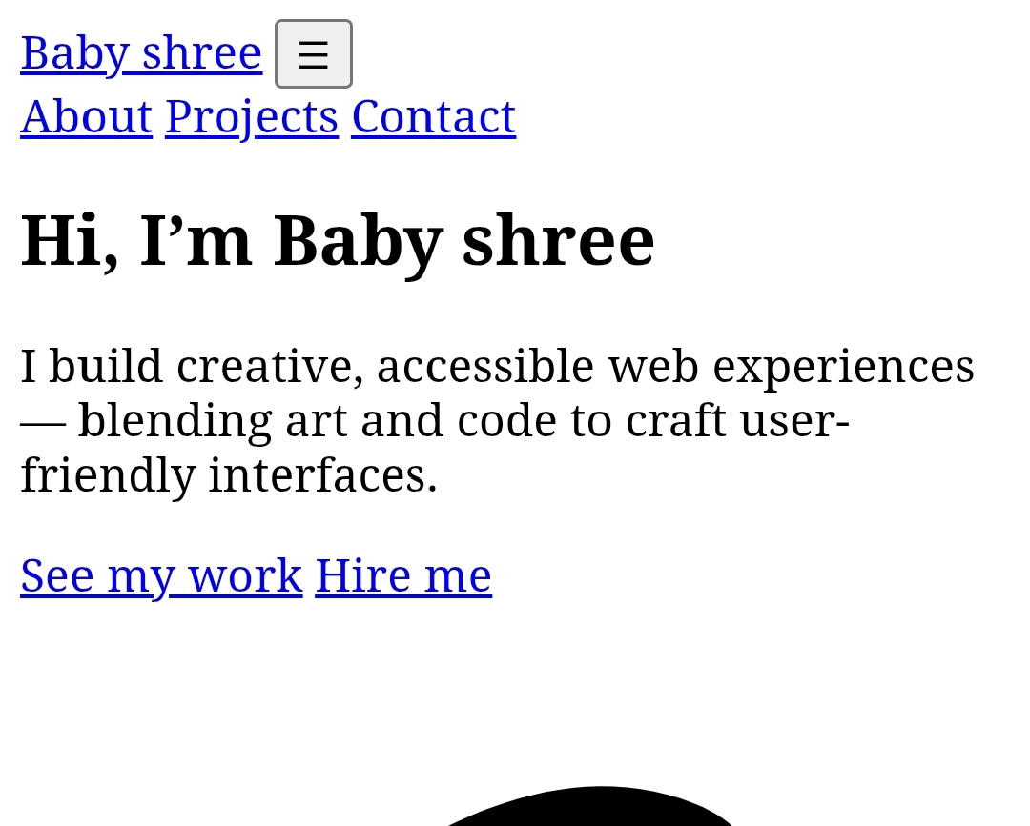

Slide 12
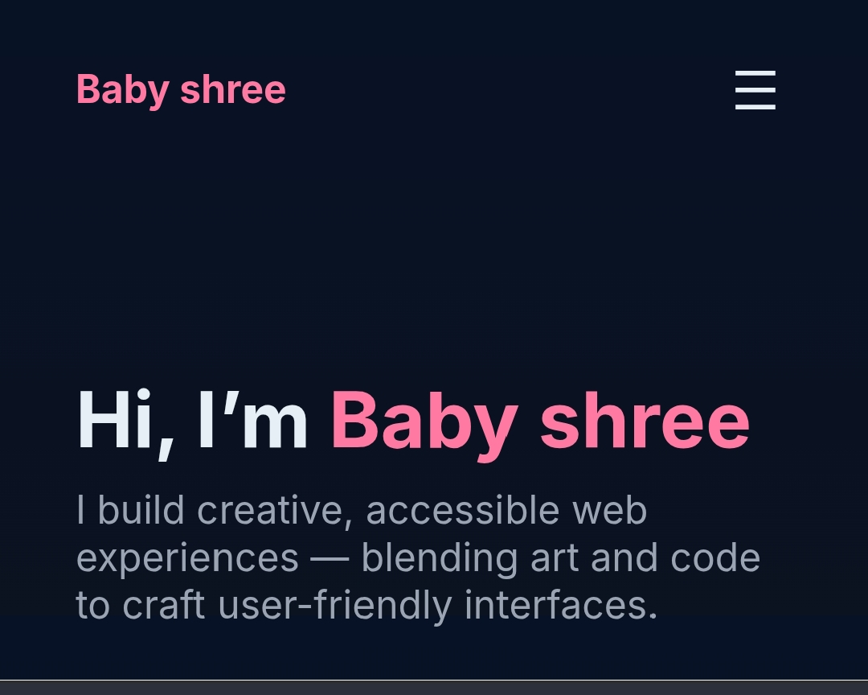

Slide 13
Conclusion
My personal portfolio reflects my journey, skills, and passion for continuous learning and creativity. It serves as a space where I showcase my projects, highlight my problem-solving abilities, and demonstrate my commitment to building user-friendly, innovative, and impactful digital experiences. This portfolio is not just a collection of work, but also a representation of my growth and aspirations. I look forward to expanding it further as I continue to explore new challenges and opportunities in my career.

Slide 14
GitHub Link
https://github.com/babyshreepoongodi-creator/Baby-shree-.git

Slide 15
THANK YOU

